Slide 1




GUS – the potential for exploring children’s rights, social justice and intersectionality
SUII – Children’s Rights Programme 2014

Slide 2
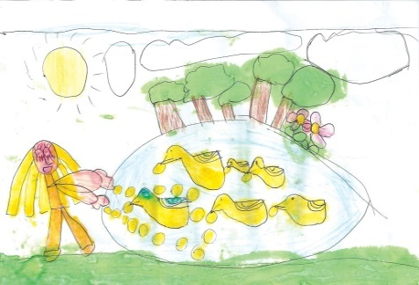
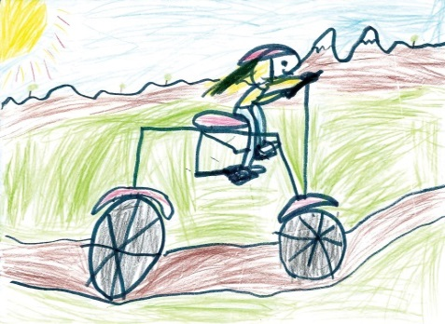
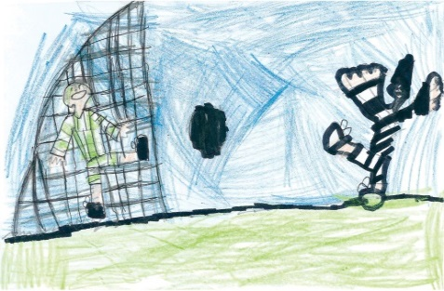
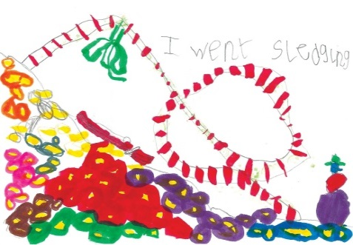
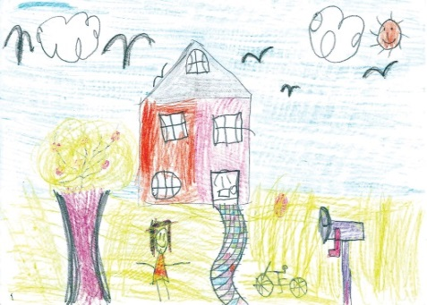
Overview
  Overview of the study
  Potential of GUS for exploring children’s rights, social justice and intersectionality
  Highlighting intersectionality – disability and disadvantage - The impact of disability on the lives of young children - findings

Slide 3
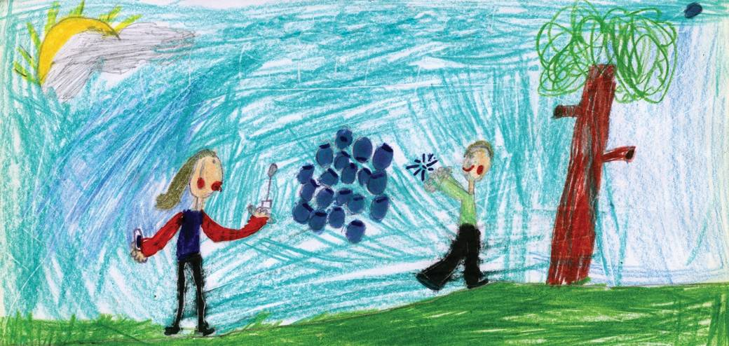
Overview of the study

Slide 4

The purpose of GUS
“To generate, through robust methods, specifically Scottish data about outcomes throughout childhood and into adulthood for children growing up in Scotland across a range of key domains:
Cognitive, social, emotional and behavioural development
Physical and mental health and wellbeing
Childcare, education and employment
Home, family, community and social networks
Involvement in offending and risky behaviour
Such data will encompass, in particular, topics where Scottish evidence is lacking and policy areas where Scotland differs from the rest of the UK.”

Slide 5


Study design: overview
  National sample capable of analysis by urban/rural, deprived/non-deprived and other sub-groups of interest
  Sample drawn from Child Benefit Records
    Good coverage
    Some limitations
  Three cohorts:
    Birth cohort 1: 5217 children, born 2004/05, aged 10.5 months at the 1st interview
    Child cohort: 2859 children, born 2002/03, aged 34.5 months at the 1st interview
    Birth cohort 2: 6128 children, born 2010/11 aged 10.5 months at the 1st interview

Slide 6
Ages and stages
Child’s age | Cohort/Year of data collection
 | Child cohort | Birth cohort 1 | Birth cohort 2
10 months |  | 2005/06 | 2010/11
Age 2 |  | 2006/07
Age 3 | 2005/06 | 2007/08 | 2013
Age 4 | 2006/07 | 2008/09
Age 5 | 2007/08 | 2009/10 | 2015
Age 6 | 2008/09 | 2010/11
Age 8 |  | 2012/13
Primary 6 (Age 10) |  | 2014/15
2014
Web survey
Web survey
2013/14
2015/16
Web survey

Slide 7
Cross-sectional time-specific
Child’s age | Child cohort (CC) | Birth cohort 1 (BC1) | Birth cohort 2 (BC2)
10 months |  | 2005/06 | 2010/11
Age 2 |  | 2006/07
Age 3 | 2005/06 | 2007/08 | 2013
Age 4 | 2006/07 | 2008/09
Age 5 | 2007/08 | 2009/10 | 2015
Age 6 | 2008/09 | 2010/11
Age 8 |  | 2012/13
Primary 6 (Age 10) |  | 2014/15

Slide 8
Cross-sectional time-series
Child’s age | Child cohort (CC) | Birth cohort 1 (BC1) | Birth cohort 2 (BC2)
10 months |  | 2005/06 | 2010/11
Age 2 |  | 2006/07
Age 3 | 2005/06 | 2007/08 | 2013
Age 4 | 2006/07 | 2008/09
Age 5 | 2007/08 | 2009/10 | 2015
Age 6 | 2008/09 | 2010/11
Age 8 |  | 2012/13
Primary 6 (Age 10) |  | 2014/15

Slide 9
Longitudinal data
Child’s age | Child cohort (CC) | Birth cohort 1 (BC1) | Birth cohort 2 (BC2)
10 months |  | 2005/06 | 2010/11
Age 2 |  | 2006/07
Age 3 | 2005/06 | 2007/08 | 2013
Age 4 | 2006/07 | 2008/09
Age 5 | 2007/08 | 2009/10 | 2015
Age 6 | 2008/09 | 2010/11
Age 8 |  | 2012/13
Primary 6 (Age 10) |  | 2014/15
Notes:
…

Slide 10
Sources of information
10mths | Age 2 | Age 3 | Age 4 | Age 5 | Age 6 | Age 8 | P6
BC1 & BC2 | BC1 | CC, BC1, BC2 | CC & BC1 | CC, BC1, BC2 | BC1 | BC1 (& BC2?) | BC1 (& BC2?)
Main carer | Main carer | Main carer | Main carer | Main carer | Main carer | Main carer | Main carer
 | Partner
 |  |  |  |  |  | Child | Child
 | Ch. height & weight |  | Ch. height & weight |  | Ch. height & weight | Ch. height & weight | Ch. height & weight
 |  | Cognitive assessmts |  | Cognitive assessmts |  |  | Cognitive assessmts
Health records | Health records | Health records | Health records | Health records | Health records | Health records | Health records
 |  | Pre-School details | Pre-School details | School records | School records | School records | School records
Interviews
Obj. assessment
Linked admin

Slide 11
Response and attrition rates
 | No. cases achieved | Response rate
 |  | As % of issued | As % of sw1 achieved
Sweep 1 – BC1 | 5217 | 80% | 100%
Sweep 1 – BC2 | 6127 | 65% | 100%
Sweep 2 | 4512 | 88% | 86%
Sweep 3 | 4193 | 90% | 80%
Sweep 4 | 3994 | 91% | 77%
Sweep 5 | 3833 | 92% | 74%
Sweep 6 | 3657 | 87% | 70%
Sweep 7 | 3453 | 83% | 66%

Slide 12
Main interview: core topics
  Household composition and family demographics
  Non-resident parents
  Parental support
  Parenting
  Childcare
  Child health and development
  Activities
  Education and employment
  Income and benefits
  Housing and accommodation

Slide 13
Main interview: other topics
  Pre-school
  Primary school
  Pregnancy and birth
  Parental health and well-being
  Material deprivation
  Food and eating
  Neighbourhood and community
  Housing and transport
  Social networks and social capital

Slide 14
Harmonised Questions
Ethnicity
Religion
Education

Slide 15
Key analysis variables
  Individual level (parent or child)
    e.g. age of mother at birth, educational qualifications, ethnicity, religion, employment status, social class (NS-SEC)
  Household level
    e.g. family type, household composition, household income, housing tenure
  Area level
    Urban/rural characteristics, area deprivation (SIMD), health board area (for larger health boards, at least 250 families in sample – others are aggregated)

Slide 16
Child outcomes
  Physical health – general health (as rated by parents), accidents & injuries, birth weight etc.
  Social, emotional and behavioural development – as measured by the SDQ (Strengths and Difficulties Questionnaire) – domains: hyperactivity; emotional problems; conduct problems; peer problems; pro-social behaviour
  Cognitive development – vocabulary and problem solving skills as measured by BASII (British Ability Scales)
  Recommend reading Data Documentation and Data Workshop materials:
  http://growingupinscotland.org.uk/using-gus-data/

Slide 17
Social justice
  Some key reports:
  ‘Health inequalities in the early years’ (2010) Catherine Bromley and Sarah Cunningham-Burley
  ‘Children’s social, emotional and behavioural characteristics at entry to primary school’ (2010) Paul Bradshaw and Sarah Tipping
  ‘The circumstances of persistently poor children’ (2010) Barnes, M. Chanfreau, J., Tomaszewski, W.
  ‘Changes in child cognitive ability in the pre-school years’ (2011) Paul Bradshaw
  All available from:
  http://growingupinscotland.org.uk/publications

Slide 18

Children’s rights

Slide 19
The impact of disability on the lives of young children

Slide 20
Research questions
What are the demographics of children with a disability?
How does the mother's experience of pregnancy and birth (with a child disabled from birth) differ from parents with a non-disabled child?
How does disability affect:
  the child-parent relationship?
  family structure and couple relationships?
  parents’ mental health and wellbeing
How does child development differ between disabled and non-disabled children?
What are parents' experiences of services for disabled children (in terms of information, usefulness, accessibility and availability)?
What type of information/support do parents with disabled children most value?
What are the barriers to accessing childcare and pre-school education?

Slide 21
Defining disability
For the initial analysis children were defined as disabled if their main carer had answered 'yes' to the following question: Does ^ChildName have any longstanding illness or disability? By longstanding I mean anything that has troubled ^him over a period of time or that is likely to affect ^him over a period of time?
And from age three onwards, those who answered 'yes' to the following question were also included: When we spoke to you last time you said that ^ChildName had a longstanding illness or disability. Can I just check does ^ChildName still have this longstanding illness or disability?
Further analysis was also carried out using an additional definition of 'limiting' disability where, from age 2 onwards, parents had also answered 'yes' to the following question: Does this/Do these condition(s) or health problem(s) limit him/her at play or from joining in any other activity normal for a child his/her age?
Notes:
The Equality Act 2010 states that "A person has a disability…if he has a physical or mental impairment which has a substantial and long-term adverse effect on his ability to carry out normal day to day activities".
The aim for this analysis was to define 'disability' based on the definition used within the Equality Act 2010, while also accounting for other definitions of disability, including additional educational support needs. A child or young person is said to have 'additional support needs' if they need more - or different - support to what is normally provided in schools or pre-schools to children of the same age.
The definition of disability for this analysis that was broadly in line with the aim outlined above and could be achieved from GUS data consistently at multiple sweeps was obtained from affirmative answers to the following question:

Slide 22
Prevalence of disability
Notes:
12% of children (n=690) were reported as having a disability at 10 months of age. This increased with age; by age six, 19% (n=680) of children were reported to have a disability.
2% of children (n=94) had a limiting disability at age 2. This had increased slightly to 5% (n=167) at age 6.

Slide 23
% of children living in most deprived 20% of areas by age and disability status
Notes:
Our analysis showed that children with a disability were significantly more likely than non-disabled children to be living in disadvantaged circumstances.
This graph displays the proportion of disabled and non-disabled children who lived in the most deprived 20% areas in Scotland
As you can see, at each age point, children with a disability were significantly more likely to be living in the most deprived than were non-disabled children.
The pattern is similar across multiple measures of social disadvantage, for example:
At ages three and five, disabled children were more likely than non-disabled children to be living in households in the lowest income quintile. For example, at age five, 31% of disabled children lived in a household in the lowest income quintile compared with 22% of non-disabled children.
A higher proportion of children with a disability than nondisabled children had parents who were not in paid work and lived in social or private rented accommodation.

Slide 24
Differences between disabled and non-disabled children
Compared with non-disabled children, disabled children were more likely to have:
(Child development)
  Missed key motor developmental milestones at 10 months and age 3
  Lower problem solving and vocabulary ability at ages 3 and 5
  Higher levels of social, emotional and behavioural difficulties at ages 4 and 5
(Family structure, couple relationships and parental wellbeing)
  Parents with less secure relationships and/or who separated before the child was aged six
  Parents with lower mental wellbeing, lower parent-child ‘warmth’ and higher parental stress
(Parents’ experience of services and attitudes to support)
  Parents drawing on greater levels of information on child health and behaviour
  Parents with slightly more negative perceptions of seeking and receiving support
  Parents with slightly lower satisfaction with childcare

Slide 25
After controlling for background characteristics…
Compared with non-disabled children, disabled children were more likely to have:
Child development
  Missed key motor developmental milestones at 10 months and age 3
  Lower problem solving and vocabulary ability at ages 3 and 5
  Higher levels of social, emotional and behavioural difficulties at ages 4 and 5
Family structure, couple relationships and parental wellbeing
  Parents with less secure relationships and/or who separated before the child was aged six
  (Only if a limiting disability)…Parents with lower mental wellbeing, lower parent-child ‘warmth’ and higher parental stress Parents’ experience of services and attitudes to support
  Parents drawing on greater levels of information on child health and behaviour
  Parents with slightly more negative perceptions of seeking and receiving support
  Parents with slightly lower satisfaction with childcare

Slide 26
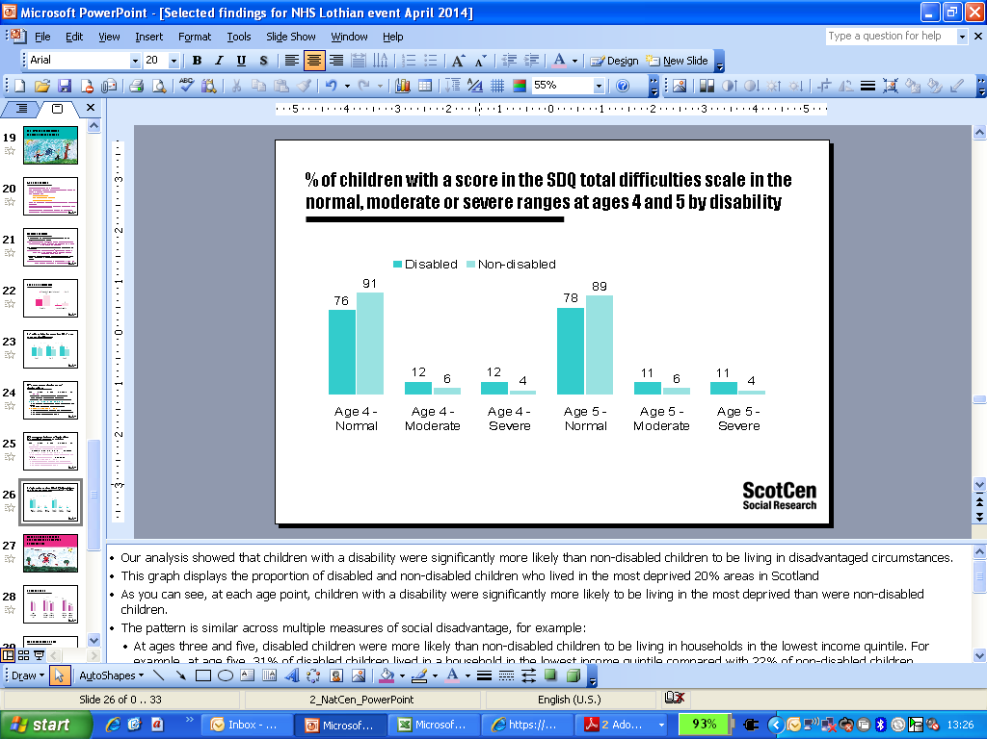
% of children with a score in the SDQ total difficulties scale in the normal, moderate or severe ranges at ages 4 and 5 by disability

Slide 27
Summary
Using the definition applied in this report, the differences between disabled and non-disabled children are not huge
It appears that the clear differences in the socio-economic characteristics between disabled and non-disabled children may be behind the many other differences between these children.
Having a disability was independently linked with:
  A greater likelihood of having early social, emotional or behavioural difficulties.
  For limiting disabilities: lower parent-child warmth and higher parental stress.
Other differences not observed potentially because of: the definition applied; sample size; measures used

Slide 28
Conclusions
GUS provides a powerful source of data for anyone wishing to carry out quantitative research relating to children’s identities and their everyday life experiences and outcomes.
Some analysis has already explored ways in which identities intersect e.g. disability and income/ disadvantage.
Please get in touch if you would like more information.
And let us know if you plan to use the data.

Slide 29












Impact: how are the study findings being used?

Slide 30





For more information about GUS and to download research findings, please visit: www.growingupinscotland.org.uk
Or contact:
Paul Bradshaw, Senior Research Director
paul.bradshaw@scotcen.org.uk
Lesley Kelly, GUS Dissemination Officer
lesley.kelly@ed.ac.uk
Follow us on Twitter @growingupinscot
GUS is funded by the Scottish Government and is carried out by the ScotCen Social Research in collaboration with the Centre for Research on Families and Relationships (CRFR) at the University of Edinburgh and the MRC Social & Public Health Sciences Unit at Glasgow University

